Slide 1
Accessible Documents: Word to PDF
Gaeir Dietrich • HTCTU Director
www.htctu.net • www.toolsthatinspire.com
Notes:
www.htctu.net * Access to IT
1
1

Slide 2
Copyright
This material is copyrighted under Creative Commons by the High Tech Center Training Unit 2017
Permission is given to reproduce for educational use
Attribution needs to be given: “High Tech Center Training Unit of the California Community Colleges”
Material may not be sold or altered

Slide 3
Creating Materials
Online documents
Must be text (not scans)
Have structure (headings, etc.)
Follow the LIST
Graphics
Add “alt text”—brief description
Videos and multimedia
Captioned
Audio description or accommodate

Slide 4
Accessible Documents
For maximum accessibility include both the PDF and the Word document online
PDF and RTF/DOC/DOCX
PDF and LaTeX/DOCX
If concerned about security with Word, can apply permissions (under File)
Sometimes an alternative text document may be required—and that’s okay!

Slide 5
Disclaimer
If you are an individual with a disability and need a greater level of accessibility for any document on this site, please contact….
Contact information ought to include
Name
Email address
Phone number

Slide 6
Good Alt Text

Slide 7
Describing Graphics
First figure out the purpose (intent) of the graphic.
Is it decoration or information?
If information, what does the graphic convey?
What is it?
Does the student need to do something with the graphic (part of an exercise)?

Slide 8
Informational Graphics
Keep descriptions short
12 words or fewer is usually best
Do not repeat caption or information already in text
In some cases where more is needed, DSPS can create tactile graphics
Tactile graphics are raised line interpretations of the graphic

Slide 9
Text in Graphics
If graphic contains important (i.e., text that is meant to be read for meaning), include the text in the alt text
A logo, for example, may contain a “tag line” in addition to the name
Include all text
A street scene may include signs which are not important
Do not need to include such text

Slide 10
No One Right Way
There is no single best way to describe graphics.
Focus on “what the graphic is,” rather than “how it looks”
Just remember…
Keep context in mind
Ask yourself: Is this something the person really needs to hear?

Slide 11
Exercise 1
In a book about health, this full-page photo appears at the beginning of a chapter on nutrition:

Slide 12
Possible Alt Text Exercise 1
The photo is decorative.
It is simply illustrating the theme of the book.
Keep the description simple:
People biking
Cyclists
If you really want more…
3 people cycling along a river

Slide 13
Logo Example 1
Kansas City Kansas Community College
Presents an Evening of Jazz
Come join us for two hours of wonderful jazz by the lake. …

Slide 14
Possible Alt Text Logo 1
The logo is mostly decorative, somewhat informational.
Logo is branding, but is essentially decorative from the user’s viewpoint.
Keep it simple; first time include all text.
Kansas City Kansas Community College logo, Making Life Better
KCKCC logo

Slide 15
Logo Example 2
In marketing your business, the design of a logo can make a big impression or can be a waste of money. The logo needs to be attractive but not dominate other information presented along with the logo. In the example below, what catches your attention?

Slide 16
Possible Alt Text Logo 2
The logo is informational.
This time, the logo is a specific example and requires a more lengthy description.
Focus on what the student needs to know:
Interlocking blue K and red C block letters on left with the words “Making Life Better” in red italics above the college name in black italics blocked and underlined with a blue line.
Notes:
Robert: two opposite interns
Gaeir: When a graphic is part of an exercise, a lengthier description is required.

Slide 17
To Be Clear
The document creator is responsible for a brief description
Access
When more is required, disability services can create tactile graphics (graphics that can be felt)
Accommodation

Slide 18
Hands-On with MS Word
Use Your LIST

Slide 19
Helpful Acronym
Use this “colored” LIST for access!
Links
Images
Structure
Table
And watch your color contrast!

Slide 20
Use Color Carefully!
Do not represent information ONLY with color
Use a combination of color and text/ symbols
Color contrast must be clear; foreground and background clearly differentiated
Black on white—good
Yellow on white—not good

Slide 21
Color Contrast Help
Color Contrast Analyzer (CCA)
http://www.paciellogroup.com/resources/contrastanalyser/
http://colorsafe.co
Shows colors you can use together
Color Simulators
http://www.color-blindness.com/coblis-color-blindness-simulator/
http://colororacle.org/

Slide 22
L is for Links
Instead of …
Click here for document X
Use the name or description as the hyperlink
Document X has the information you need
Do not use underlining for anything other than hyperlinks

Slide 23
Links Benefits
Benefit for you
You don’t lose connection with your materials when you make edits
Linking to documents and learning objects by their names allows you to keep track of them easily!
Benefit for others
What you get when you click is clear
Screen reader users can use a “links list”

Slide 24
How to Create a Link
Select the text for the hyperlink’s name
Right-click
Choose “Hyperlink…”
Browse to the object you want to link or enter the URL
Make sure the material you link to is already online!

Slide 25
Links Summary
Link names should make sense out of context
Do not use underlining for anything other than hyperlinks

Slide 26
Checklist (L)
√ Links

Slide 27
I is for Images
Add very brief text description
If graphic is simply decoration
Provide a super brief description (e.g., “ivy border”)
OR make it “background” in PDF
OR use a null tag on the web “_”
If graphic is informative
Describe as succinctly as possible

Slide 28
Images Benefits
Benefits for you
Requires “out of the box” thinking
Text becomes searchable online
Benefits for others
Text appears on mouse-over (PDF or HTML), clarifying purpose of graphic
Reinforces vocabulary
Higher “hit” on Google

Slide 29
How to Create Alt Text
Right click on graphic
“Format Picture”
“Alt Text”
Enter text in “description”
Ignore “title”
Newer versions of Word do not have an “Okay” button—the alt text saves automatically

Slide 30
Alt Text
Right click on picture
At bottom of window, choose Alt Text
Note: Put the alt text where it says “Description” Ignore “Title”

Slide 31
New in Word 2016
Word 2016 will now try to identify graphics and automatically adds alt text
STILL needs to be checked for accuracy
Focus will be on what the graphic is, will not understand context

Slide 32
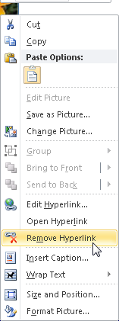
Hyperlinked Graphics
Graphics copied from the Internet sometimes retain their hyperlink and can cause issues
To remove the hyperlink, right click on graphic and choose “Remove Hyperlink”

Slide 33
Be Aware
Graphics work best when they are placed “inline” with text
Other programs are not sure where to place graphics that are not inline
If you want to “wrap” text around the graphic, use columns
If you want to use graphics that are not inline, check the reading order in PDF

Slide 34
Images Summary
Add alt text
If graphic copied from the internet, remove any attached hyperlinks
Place images “inline”
Do not wrap text around them
Can get same effect using columns, and that is fine
If images have important text, include that text in the alt text as needed

Slide 35
Checklist (L-I)
√ Links
√ Images

Slide 36
S is for Structure (& Styles)
Use styles
Headings
Use in order (heading 1, then 2, etc.); do not skip numbers
Lists / bulleted lists / numbered lists
Index (for stairstep indents, outlines)
DO NOT use text boxes
*Note: headings provide navigation points—both for screen reader users and for anyone using the “navigation pane.”

Slide 37
Styles Benefits
Benefits for you
Allows easy changing and editing
Improves document navigation
Can use “outline” view to rearrange sections
Automatic table of contents
Benefits for others
Improves document navigation for all—headings useable with screen readers

Slide 38
What is a Heading?
Headings provide structure to a document
Every document needs a Heading 1

Slide 39
Syllabus Headings Example

Slide 40
In General
Font size and readability
12 point is good
Avoid fonts that will be difficult to read online (use sans serif fonts)
Avoid using enter key for extra spacing
Use spacing in the styles or on individual paragraphs as needed
Avoid using space bar for multiple spaces

Slide 41
What’s a Style?
Paragraph Styles
Paragraph attributes
Font type & size, line spacing, indent
Affects entire paragraph
Attribute Styles
Applies only to selected characters
Font type, size, style

Slide 42
Look Under the Hood!
Turn on your hidden symbols
Button in the paragraph group
Keyboard shortcut Ctrl + Shift + *

Slide 43
Selecting Text
Double click
Triple click
Shift + arrow keys
Shift + home/end
"shift-click" technique

Slide 44
Applying Styles
Paragraph styles
Click in text, click on style name
Use format painter
Use keyboard shortcut
Attribute styles
Select text, click on style name

Slide 45
Handy Style Shortcuts
Heading One
Ctrl + Alt + 1
Heading Two
Ctrl + Alt + 2
Heading Three
Ctrl + Alt + 3
List Bullet
Ctrl + Shift + L
Notes:
45

Slide 46
More Keyboard Shortcuts
Remove manual formatting = Ctrl + Spacebar
Normal style = Ctrl + Shift + N
Change case = Shift + F3
Forced line break = Shift + Enter
Forced page break = Ctrl + Enter
Control + down arrow = moves focus to beginning of next paragraph

Slide 47
Seeing Styles
Turn on “Area Pane”
File > Word Options
Advanced > Display
Set “Style area pane width…” to 1 inch
Turn on Draft Mode
View > Draft

Slide 48
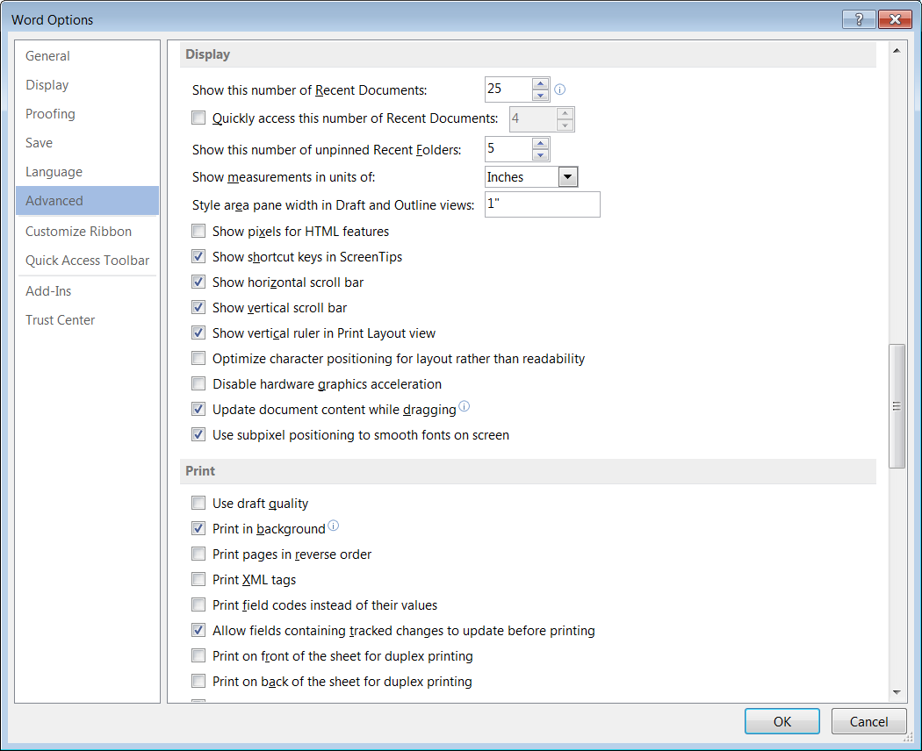
Styles Area Pane
Word Options Window will look slightly different depending on the version of Word

Slide 49
Applying List Styles
Choose all list styles from the Styles pane, NOT from the Ribbon!
The paragraph tools on the ribbon apply formatting but do not consistently change the style.

Slide 50
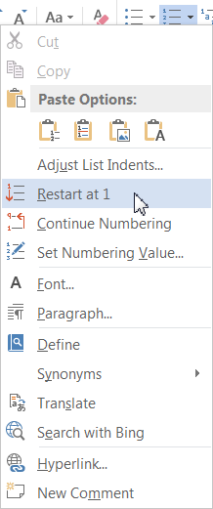
Numbered Lists
If your numbered list is using the wrong numbering, right-click the top number

Slide 51
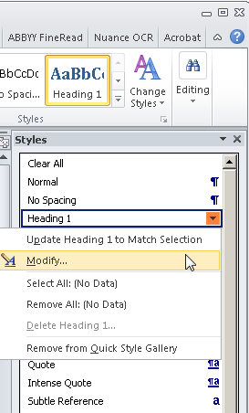
Modifying Styles
Styles can be modified in MS Word to change spacing, fonts, etc.
Open Styles pane (Ctrl + Alt + Shift + S) and mouse-over style name—click on down arrow and modify

Slide 52
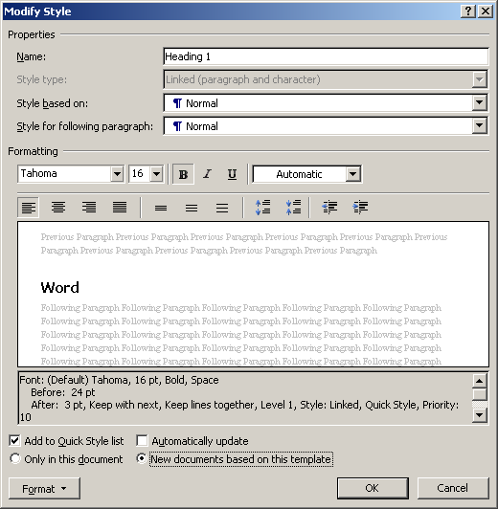
Keep Your Modifications
The Format button gives access to more style options
To keep your style changes, use the radio button for “New documents based on this template”

Slide 53
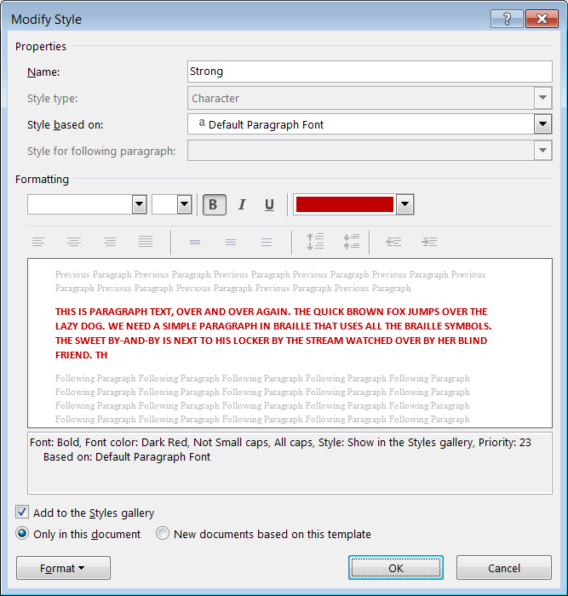
Attribute Styles
If you have text that you modify consistently, e.g. vocabulary words, you can use an attribute style
Strong = Bold
Emphasis = Italic
E.g. Styles Strong > Modify, click format to modify the font

Slide 54
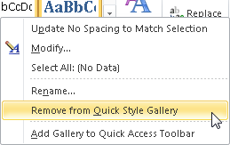
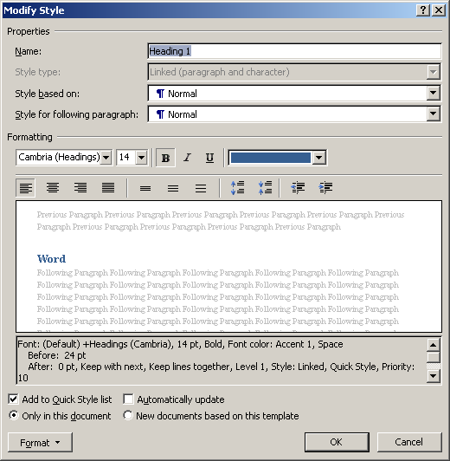
Change the Gallery
To delete from the Styles Gallery, right click and remove
To add to the gallery, choose the style > modify—check add to Quick Styles

Slide 55
Styles Summary
Use styles
Especially heading and list styles
Pay attention to font size and type
Use fonts appropriate to how document will be read
Avoid using enter key for extra spacing
Avoid using space bar for multiple spaces

Slide 56
Checklist (L-I-S)
√ Links
√ Images
√ Structure

Slide 57
T is for Table
Mark the header row* in your tables
Word calls this “Repeat as header row at top of every page”
*If first column has headers, those header cells will need to be marked in Adobe Acrobat Pro.
Do not break rows across page
Use columns instead of tabs
If absolutely necessary, use decimal tabs

Slide 58
Table Benefits
Benefits for you
Always see header row, even across multiple pages
Lessens reformatting/editing issues
Benefits to others
Screen reader users will be able to hear the header text repeated as needed
Users of large print will still see header row when enlarging text

Slide 59
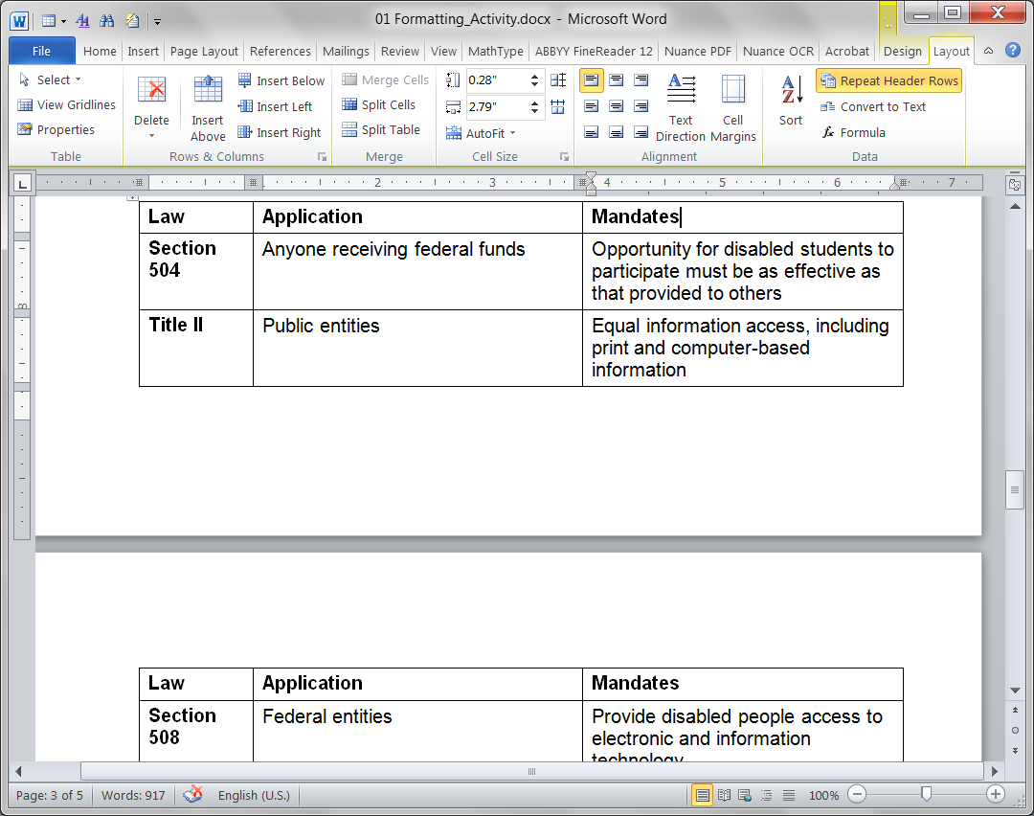
Mark Header Row
Under Table Tab > Layout > Repeat Header Row

Slide 60
Table Tip
Best not to merge cells
Creates a lot more work in PDF!
Place the table title just above the table and make it one of the headings
Heading styles automatically apply “Keep with Next” so the title will always stay with the table

Slide 61
Accessibility Option Tip
Can link to original tables in Word or Excel when greater accessibility is needed.
Accessible version of table [name]

Slide 62
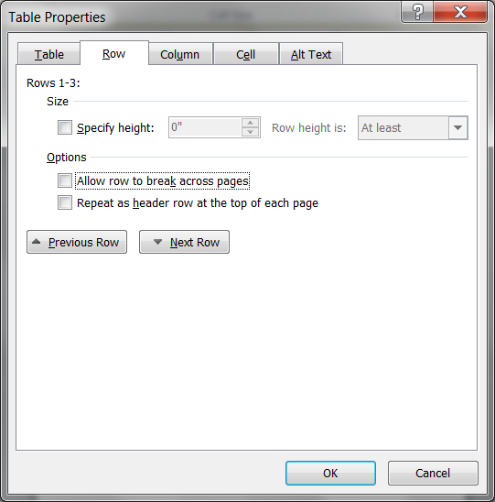
Uncheck “Break Across Page”
Layout > Properties > Row
OR right click on table and choose Properties > Row

Slide 63
Table Summary
Can add “alt text” to tables
May not be necessary on simple tables
Useful on more complex tables
Right click table and choose Properties > alt text

Slide 64
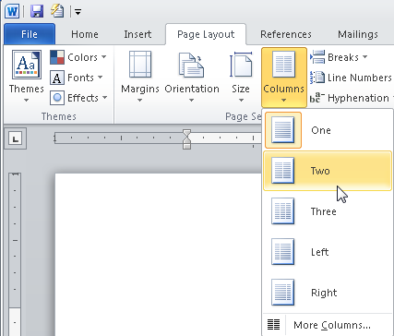
Avoid “Layout Tables”
Avoid using tables just to get columns
Instead, use the “column tool”
Select the text and choose “columns”

Slide 65
Accessible Decorative Box
Use columns and paragraph border for visual effect

Slide 66
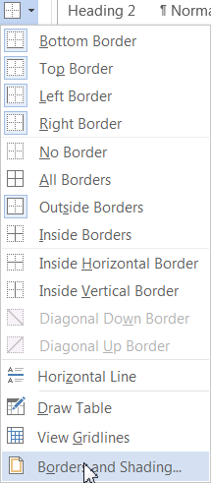
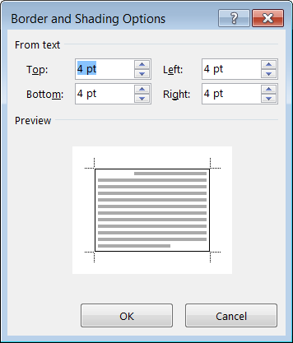
Adjust the Border Spacing
Under paragraph > Borders and Shading
Click Options > button
Adds space between border line & text

Slide 67
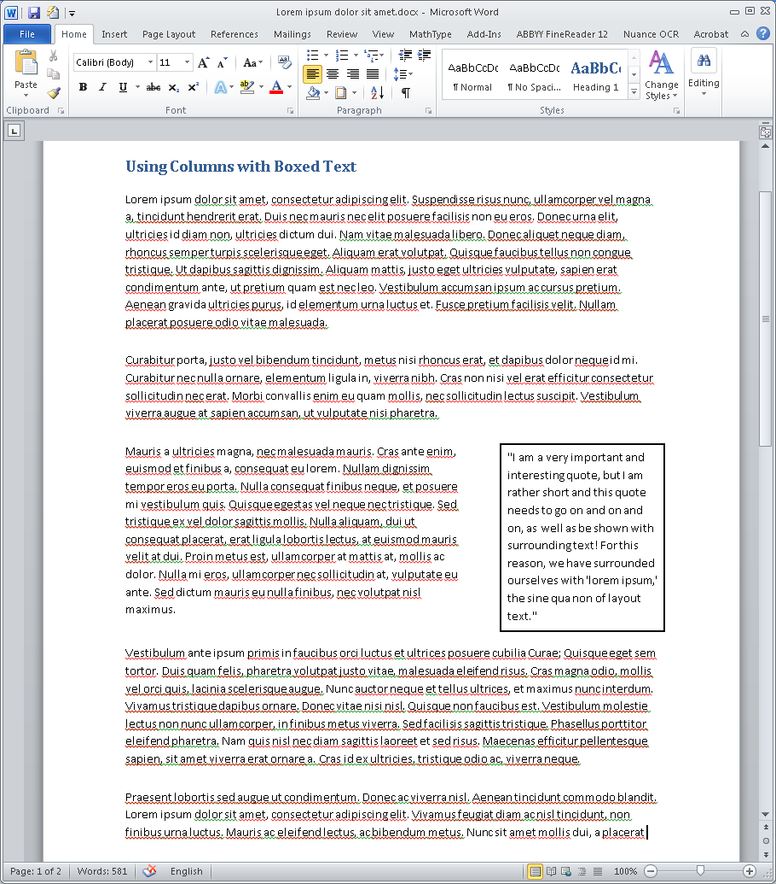
Columns for Boxed Text
Columns can be used to create “pull-out quotes” or “boxed text”
Make sure columns are set to unequal width
Use “border” to create the box

Slide 68
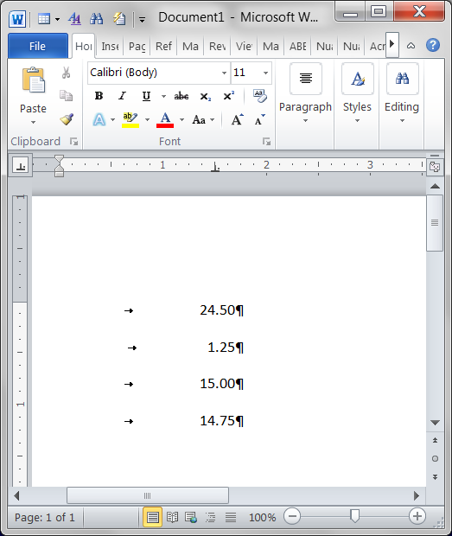
Tabs
Use ruler to set type of tab and tab location
Decimal tabs are particularly useful
Turn on “hidden” (Ctrl + Shift + *) to see tabs

Slide 69
Tab Shortcut
Ctrl + Down Arrow to jump to beginning of next paragraph

Slide 70
Columns over Tabs
Try to use columns as much as possible, rather than tabs
Other programs do not always handle tabs correctly
Columns no problem for other programs

Slide 71
Tables Summary
Mark headers (rows and columns)
Do not break rows across page
Best not to merge cells
Put table title before the table
Use columns, not tables, just for layout
For boxed text, use columns and add a decorative border
Add a table summary (alt text)

Slide 72
CheckLIST
√ Links
√ Images
√ Structure
√ Tables
And you’re done!

Slide 73
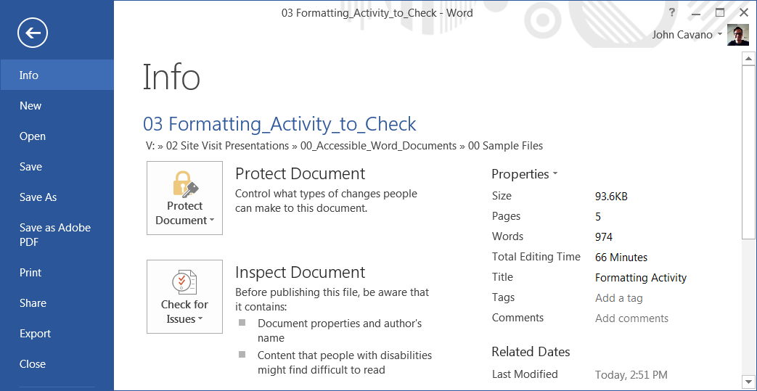
Add a Title
For accessibility, go to File > Properties > Title
Add a Title

Slide 74
Check Your “LIST”
MS Word has a very good built-in accessibility checker
File > Check for Issues

Slide 75
MS Word Built-in Checker

Slide 76
Other tools to Help!
Making Your Life Easier…

Slide 77
But what if I didn’t…
Word can help by applying “autoformat”
Autoformat will add styles to a document that has used consistent manual formatting
In other words, text was selected and manually made to look like headings
Autoformat tool is now only available when added to the Quick Access Toolbar

Slide 78
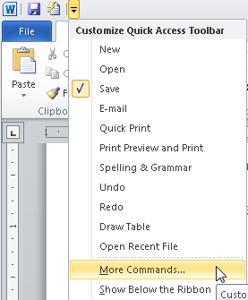
To run autoformat…
Must place “autoformat” on Quick Access Tools
Choose Customize Quick Access Toolbar
Select More Commands

Slide 79
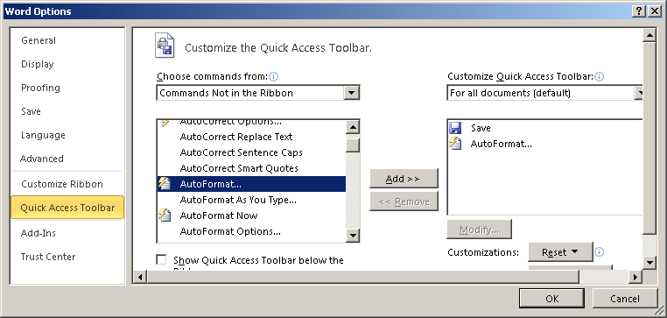
Add Tool
Add the “Autoformat” tool

Slide 80
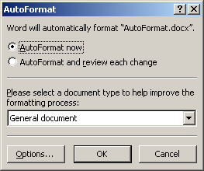
Run Autoformat
Autoformat will automatically apply styles where it can

Slide 81
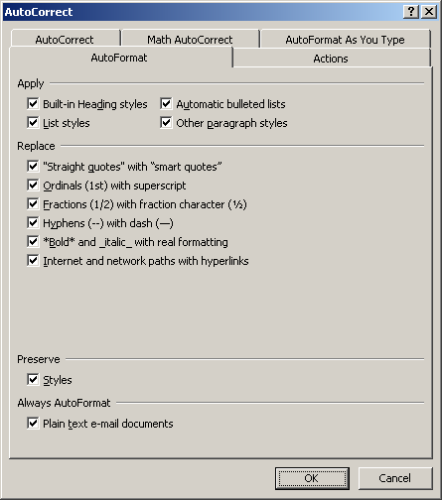
Autoformat Applies Styles
Select Options to see what Word is doing
Make sure “preserve styles” is checked to keep any you have used

Slide 82
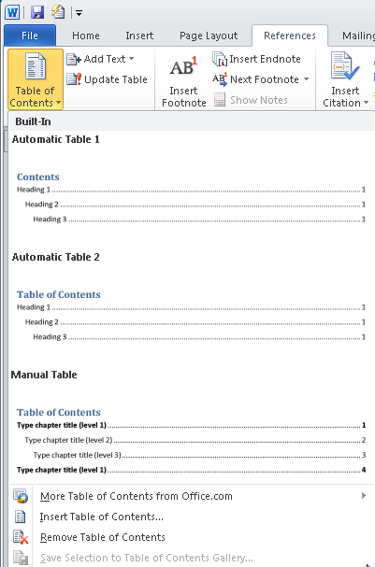
ToC
With styles, you can automate the table of contents generation
Reference > Table of Contents > Insert
Tip: Make sure your focus is where you want the ToC!

Slide 83
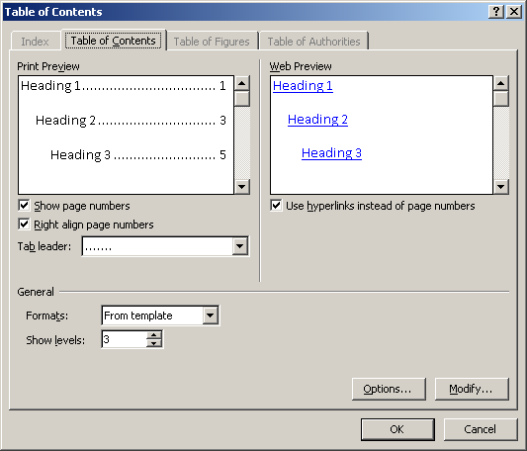
Choose Levels to Include
Have control over which levels of heading to include
To update later, just right-click on the ToC

Slide 84
Once You Have Styles
Reorder sections in “outline view”
Click on heading and drag where you want
All the subheads and associated material will move along with the heading!

Slide 85
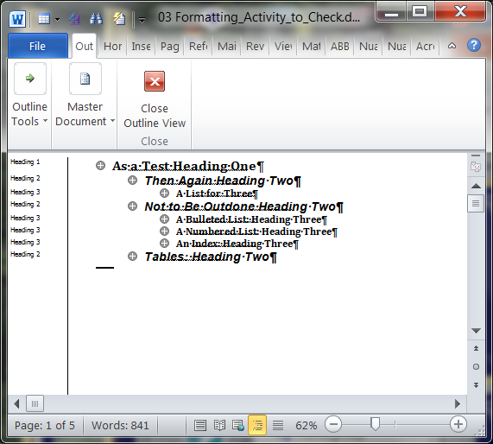
Rearrange in Outline
Choose Outline from View menu
Collapse the headings
Drag and drop a heading to rearrange

Slide 86
Creating the PDF

Slide 87
Create PDF and Run Action
Install Adobe Acrobat Pro
From the Word ribbon choose Create PDF

Slide 88
Wizard?
Do not use the Make Accessible Wizard…
If you are creating forms
Forms are tricky and require another workflow
If you have charts and graphs with text that you do not want optical character recognition run on
For scanned documents

Slide 89
No Wizard…
Also do not use the wizard if you have already added accessibility in during the document creation!

Slide 90
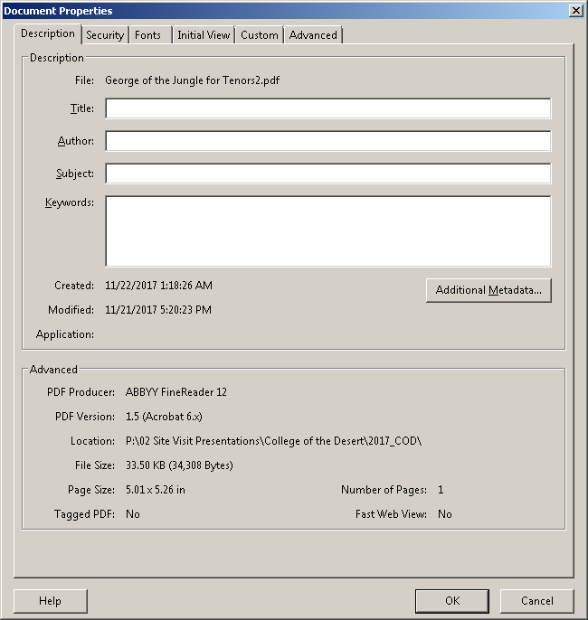
In Adobe Pro
Add a “Title”
File > Properties (Ctrl + D) enter the title in “Title” field

Slide 91
Checking the PDF
Making sure everything works in PDF

Slide 92
Easy Access in Acrobat Pro
On previously created PDFs, can use the Wizard!
Note: If you still have the original, use that!
Run the “Make Accessible” Wizard
Tools > Action > Make Accessible
Select the “Start” button
Wizard automatically fixes a host of accessibility problems!

Slide 93
Alt Text Missing?
It is easier to add alt text in the authoring tool (Word, PPT, InDesign, etc.).
Go back to the original document, add the alt text, and then convert again to PDF.

Slide 94
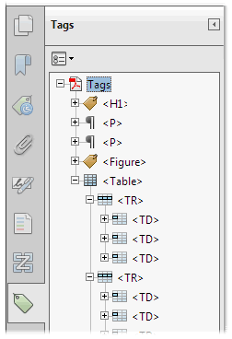
Checking in Acrobat
Tags
View > Show/Hide > Navigation Panes > Tags

Slide 95
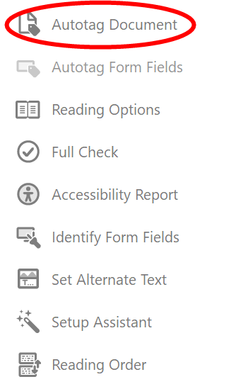
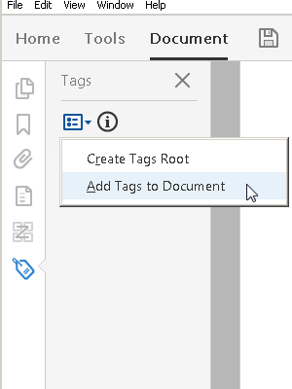
No Tags?
Tools > Accessibility > Autotag Document
OR right-click on “no tags” and select “add tags”
And tags can be changed by right-clicking on them

Slide 96
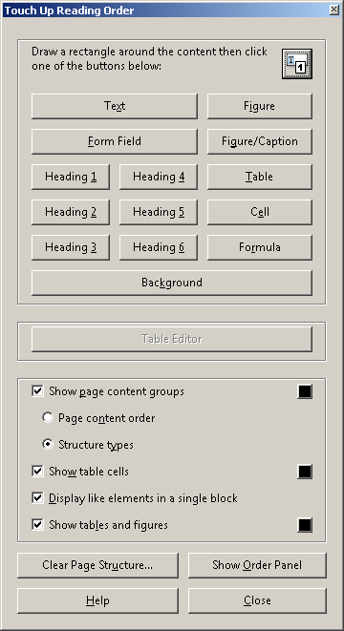
Reading Order
Occasionally a document will not read in the proper order
Accessibility > Touch Up Reading Order
Quick check? Change view to “reflow”

Slide 97
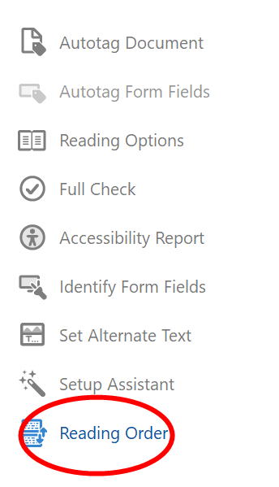
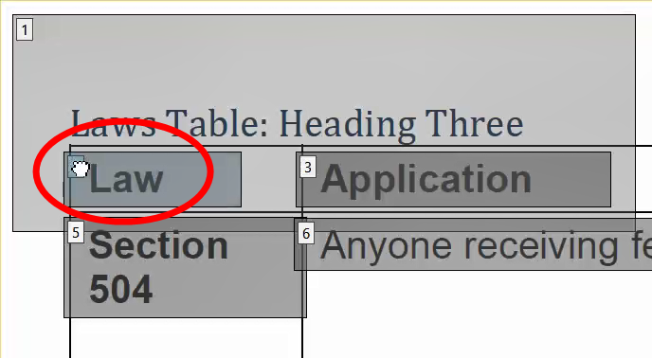
Table Editor
If a table has row headers, you will add them with the Table Editor
Click Accessibility > Reading Order
Click any table cell number

Slide 98
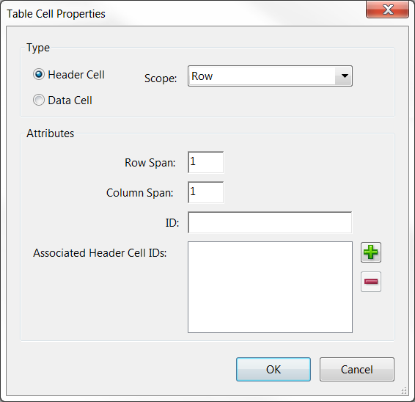
Table Editor, continued
From Touch Up, click Table Editor
Right-click a specific cell
Click Table Cell Properties
Click Header Cell
Set Scope as Row
Click OK

Slide 99
Scanning to PDF

Slide 100
Pictures Are Not Text
A scan is a picture
In order to ensure access, must run Optical Character Recognition (OCR)
Analyzes structure
Interprets text in the picture
Recommend ABBYY FineReader
Accurate, easy-to-learn OCR program
Have available for faculty

Slide 101
Adobe Pro Not Best at OCR
Adobe Acrobat Pro does not allow for editing of results
Need to be able to edit recognition results
You continue to see the “picture,” but the underlying text is hidden

Slide 102
“Real” OCR Programs
OCR = Optical Character Recognition
ABBYY FineReader (easier) or Nuance OmniPage
Allow you to have control over the process
Easy to edit results
Quickly save to a text-based PDF and run wizard
Can also save to Word

Slide 103
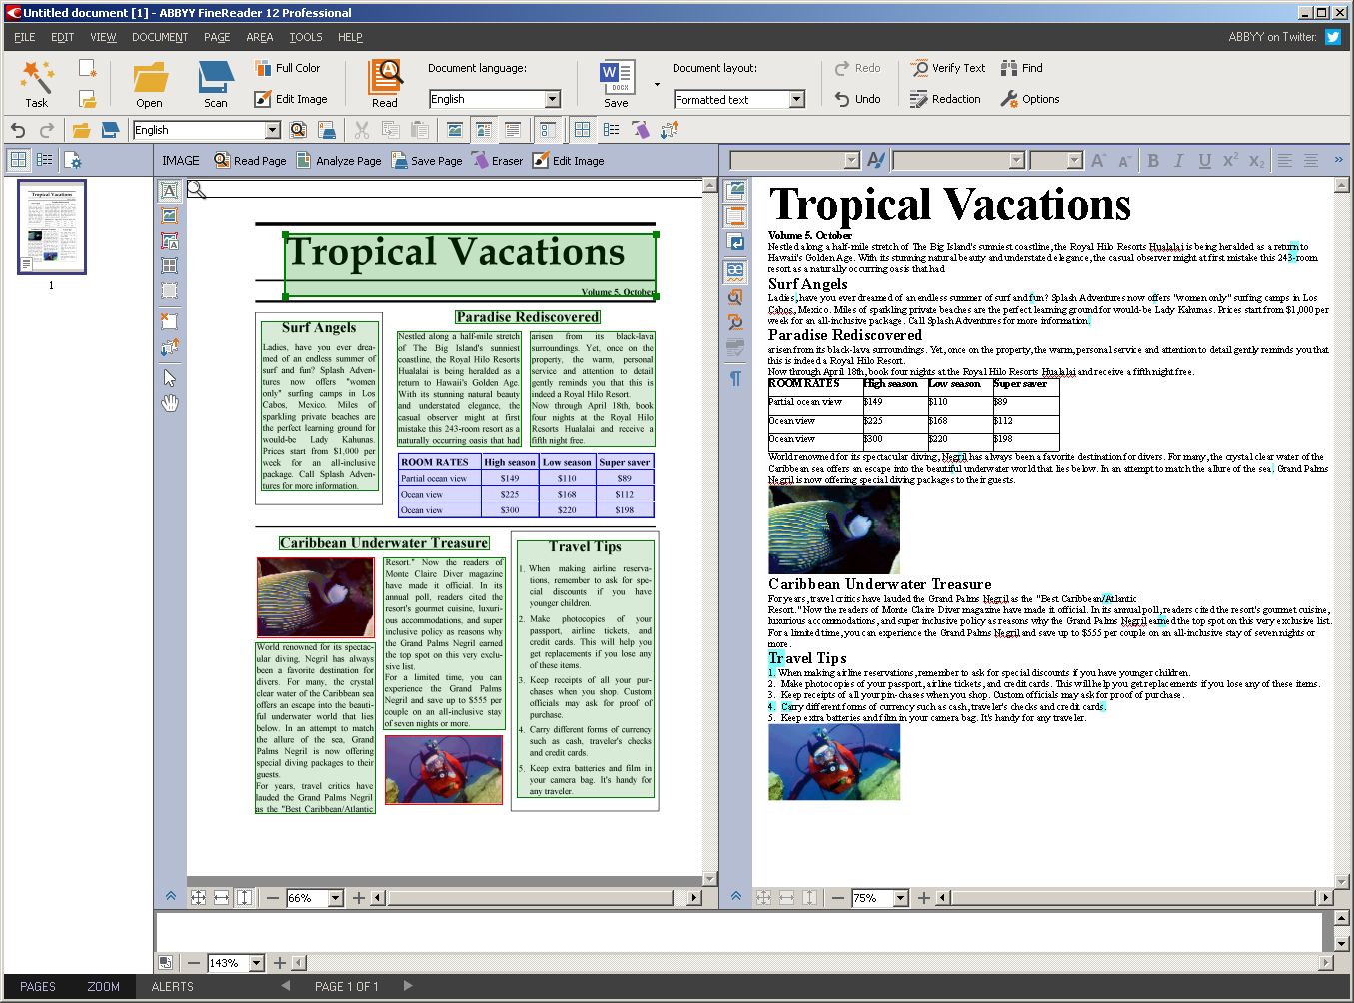
ABBYY FineReader

Slide 104
PowerPoint

Slide 105
Accessible PowerPoint
Themes
Use built-in themes (under design tab)
Allows user to adjust contrast as needed
Styles are applied automatically
Make sure the first slide uses the “title slide” layout
Use other layouts as appropriate
Give each slide a unique name

Slide 106
PPT Accessibility
Logical link names
Describe graphics
Right click, just like in word
Watch out for unused text areas in footer
Can be deleted in master slide
Built-in accessibility checker
File > Info > Check for issues

Slide 107
LIST in PPT
√ Links
Use logical link names
√ Images
Briefly describe graphics with alt text
√ Structure
Use built-in themes
Use “title” slide first
Give each slide a different title

Slide 108
LIST Continued
√ Structure
Watch out for blank boxes in the footer
√ Tables
Mark header row
Add a table summary (alt text)
Best not to merge cells

Slide 109
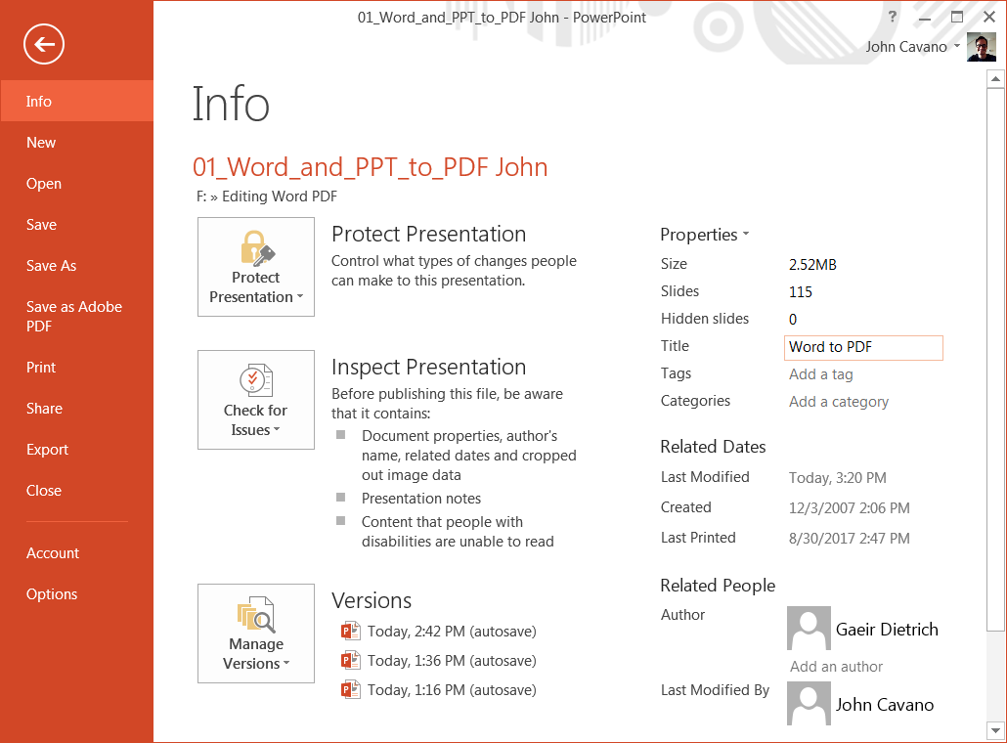
Add a Title for PowerPoint
For accessibility, go to File > Properties > Title
Add a Title

Slide 110
Canvas
Creating Accessible Online Courses

Slide 111
Creating Documents in Canvas
Still follow the LIST
Links: look for tool in the Rich Media Editor
Images: “alt text” in “insert image” window
Structure: Rich Media Editor allows you to add styles—select “Paragraph”
Tables: has built-in tools—mark all header cells under “Cell properties”

Slide 112
Accessible Canvas
Canvas tutorials available on the OEI website:
https://ccconlineed.instructure.com/courses/98
Canvas Rich Media Editor
Allows styles, alt text for images
Videos
Create transcript and upload as “subtitles”
https://guides.instructure.com/m/4152/l/719744

Slide 113
Resources
Others can help!

Slide 114
Accessible Web
W3C Guidelines
WCAG (Web Content Accessibility Guidelines) 2.0
http://www.w3.org/TR/WCAG20/
DO-IT (University of Washington)
http://www.washington.edu/doit/
WebAIM
http://webaim.org/

Slide 115
Digital Media
DCMP Captioning Key
http://www.dcmp.org/captioningkey/
NCAM – STEM
http://ncam.wgbh.org/experience_learn/educational_media/stemdx/guidelines
WGBH – Web Media
http://ncam.wgbh.org/invent_build/web_multimedia/accessible-digital-media-guide/guideline-h-multimedia

Slide 116
Online Learning
@ONE four-week course
Accessible DE
http://www.onefortraining.com/
Professional Learning Network
Hosts trainings from Lynda.com
Prolearningnetwork.cccco.edu./creating-accessible-materials
Free for CCCs

Slide 117
Accessibility Help Desk
CCC Accessibility Center
www.ccctechnology.info
Create an account so that staff can respond to queries

Slide 118
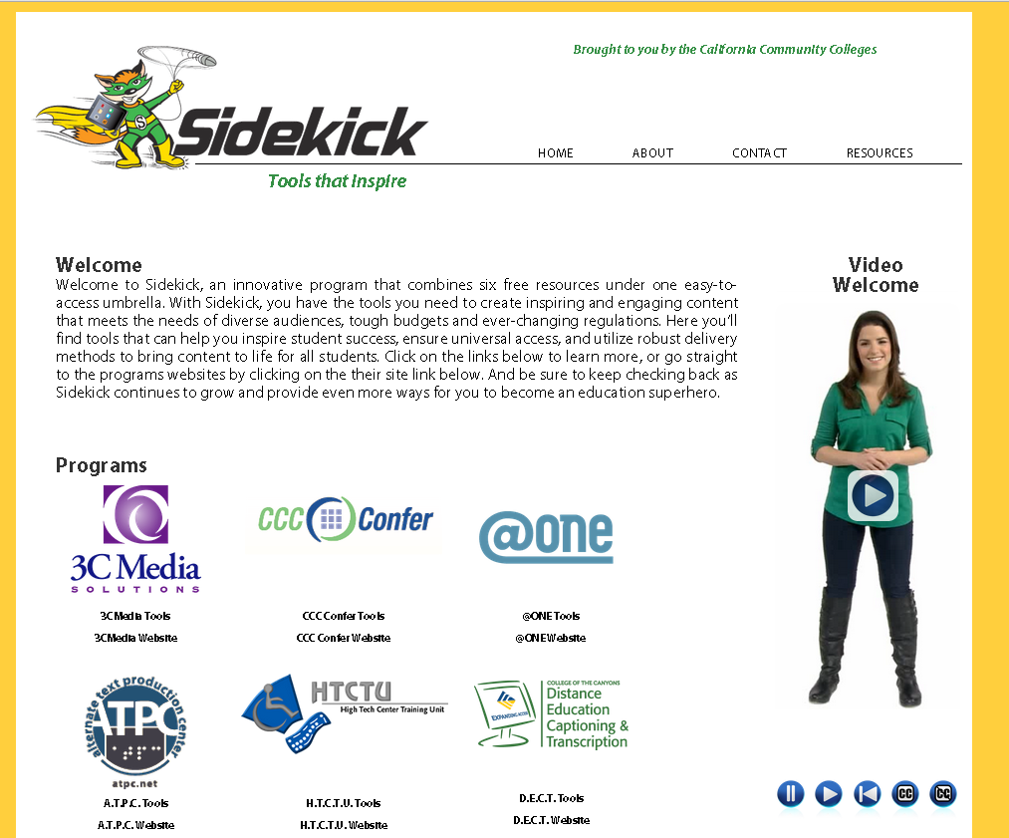
One Site for Free Assistance
Portal for free resources for the CCCs
Sidekick
www.toolsthatinspire.com

Slide 119
Thank you!
Gaeir (rhymes with “fire”) Dietrich
gdietrich@htctu.net
408-996-6047
To schedule visits, please contact our admin assistant, Erika Owens
eowens@htctu.net
408-996-4636

