Slide 1
Coverletters
More than Just the Facts

Slide 2
Proving you’re qualified!
Resumes = FACTS
Coverletter = THE STORY
Coverletter’s Job =
To directly talk about
Minimum & Preferred Qualifications

Slide 3
Coverletter: prove you’re qualified
ALL minimum qualifications
ALL desired qualifications
Any other selection criteria

Slide 6
But wait…there’s more?

Slide 8
What if I don’t address every qualification?

Slide 10
Pro tips
Reader friendly (follow order, blt pts, float)
Express eagerness throughout
Let them realize you’re the “perfect fit”
Real examples: equity & diversity
Talk about students & teaching pedagogy
Connect yourself to their campus
Weave in their language
job announcement
mission statement
department website

Slide 11
Reader friendly follow order, blt pts, float

Slide 12
DOWNLOAD & SAVE THE JOB ANNOUNCMENT!

Slide 13
Why? Reference for Letters of Recommendation

Slide 14
Why? Reference for yourself

Slide 15
Use their language

Slide 17
Brand Yourself: file name
Don’t:
Resume
“The BEST Resume”
The College’s Name
Another College’s Name
Do:
Your Name & Job Title
Use Electronic Signature (don’t scan & upload)

Slide 18
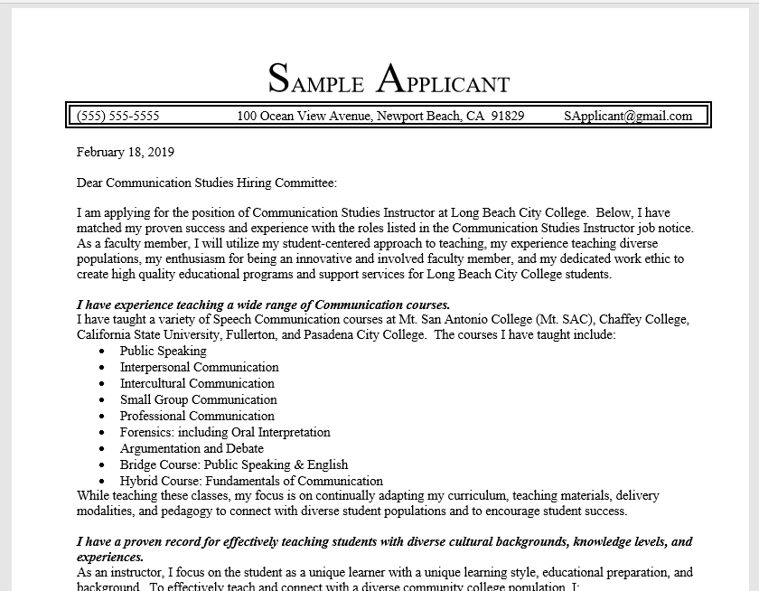
BRAND YOURSELF: Format

Slide 19
Step 3: state job title

Slide 20
Step 4: identify & Address qualifications
ALL minimum qualifications
ALL desired qualifications
Any other selection criteria

Slide 21
Address minimum qualifications first

Slide 23
Weave in desirable qualifications

Slide 24
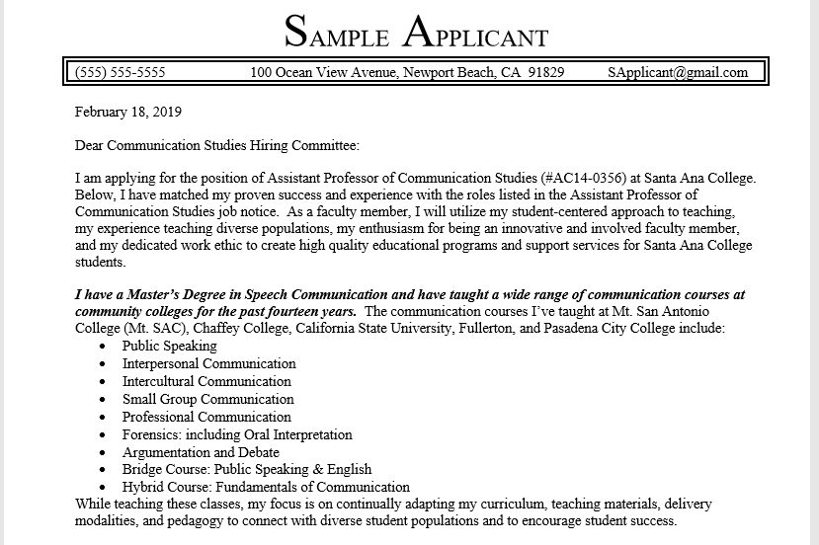

Slide 25
Give some qualifications more attention

Slide 26
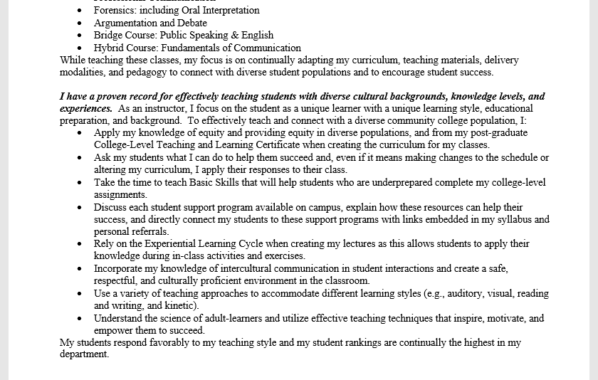

Slide 28
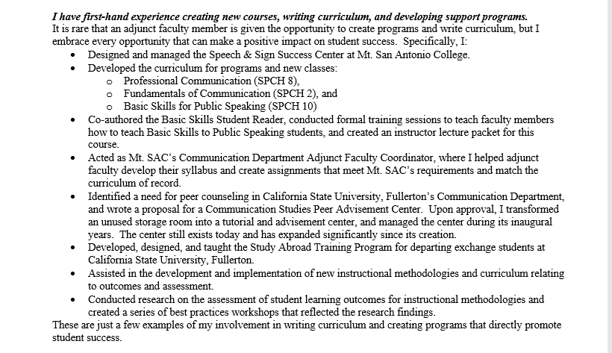

Slide 31
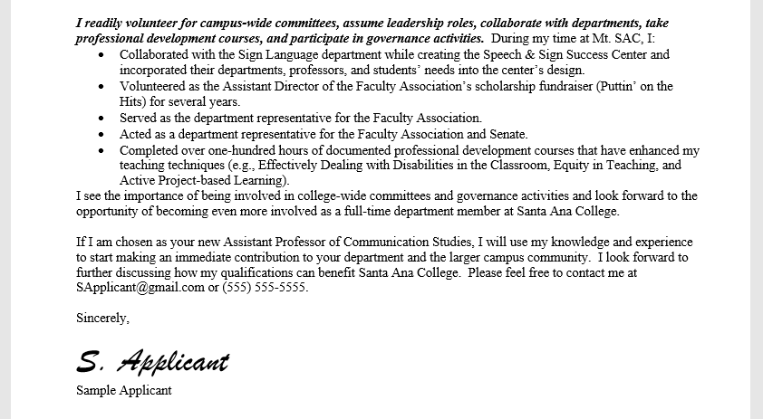

Slide 32
Personalize your Closing Statement

Slide 33
Finally… Follow instructions carefully

