Slide 1
Welcome to Fall 2022
From the Accreditation Core Team!

Slide 2
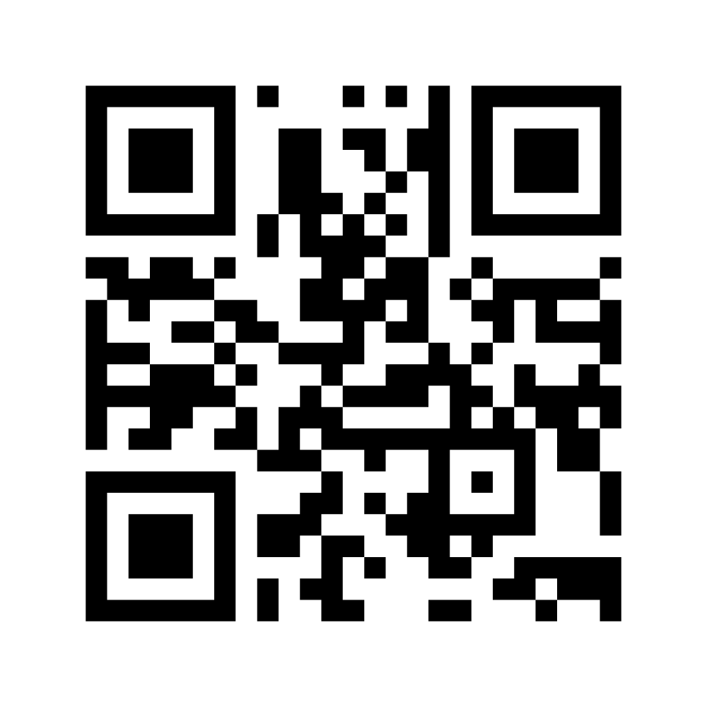
TRUE or FALSE:
Accreditation affects my daily work.

Slide 3
TRUE!
Number of college accreditation processes happening at Mt. SAC at this time: 18
There were 17 weaving teams in the spring 2022 semester.
Compliance with 21 Eligibility Requirements (ERs) will be demonstrated.
111 weavers participated in the weaving team process.
The College will give evidence on 14 standards and 121 sub-standards in the Institutional Self-Evaluation Report (ISER).

Slide 4
What is Accreditation ?
Accreditation is a practice of academic quality control
Promotes institutional excellence through application of standards
Advances meaningful and effective student learning and achievement
Provides assurance to students, the general public, & others about the quality of educational offerings
Completed through peer review
Notes:
Kelly
Note: In many other countries, colleges and universities are recognized by a government education agency, such as the Ministry of Education

Slide 5
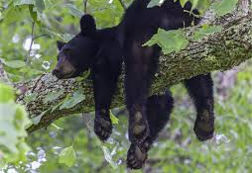
Why Bother?
Access to Federal Student Aid
Assure quality to the public and students
Credibility for degrees and credentials (transfer & employment)
Stimulates institutional innovation and improvement
Provides assurance to students, the public, and other institutions that you are achieving your mission
Notes:
Lianne

Slide 6
Four Interconnected Standards of Institutional Practice
Standard I
Standard II
Standard III
Standard IV
Mission
Instructional Programs
Human Resources
Decision-Making Roles & Processes
Physical Resources
Chief Executive Officer
Assuring Academic Quality & Institutional Effectiveness
Library & Learning Support Services
Technology Resources
Governing Board
Institutional Integrity
Student Support Services
Financial Resources
Multi-College Districts
Notes:
Kelly
Purpose—define Standards of Good Practice; to provide guidance on what makes a quality institution
All parts of institution – institutional review (not micro program level)
Broadly written for application to diverse institutions: all institutions should be able to see themselves in those standards.
Application varies by college.

Slide 7
Ongoing Day to Day Work of the College
Standard 1: Institutional Mission & Effectiveness Annual PIE Process Use mission statement for planning & decision-making Classified Senate Committees (IEC, PAC) | Standard II: Student Learning Programs & Services Teaching Assessing & evaluating SLOs Curriculum design Counseling & information literacy support Support Services
Standard III: Resources Hiring committees Facilities Advisory Committee ITAC Professional development committees Budget Committee President’s Advisory Council | Standard IV: Leadership & Governance All Committee work Classified Senate CSEA Academic Mutual Agreement Council President’s Advisory Council
Notes:
Presenter: Kelly
The work of each unit in the college supports the college mission
We can demonstrate that all the work you do as Classified supports student success
Committee work gives voice and perspective that are important to the college
Participation in PIE is key to including all voices in the integrated planning process

Slide 8
Which standard most closely aligns with your everyday work at Mt. SAC?
a. Standard I – Institutional Mission and Effectiveness
b. Standard II – Student Learning Programs & Services
c. Standard III -- Resources
d. Standard IV – Leadership & Governance
e. More than one

Slide 9
Did you know...
The college has institution-set standards (ISS) as well as stretch goals to see how well we are serving our students.
The ISS gives us data that tells us what we are doing well and where we need to grow.
Notes:
Patty Q: next slide with ISS metrics

Slide 10
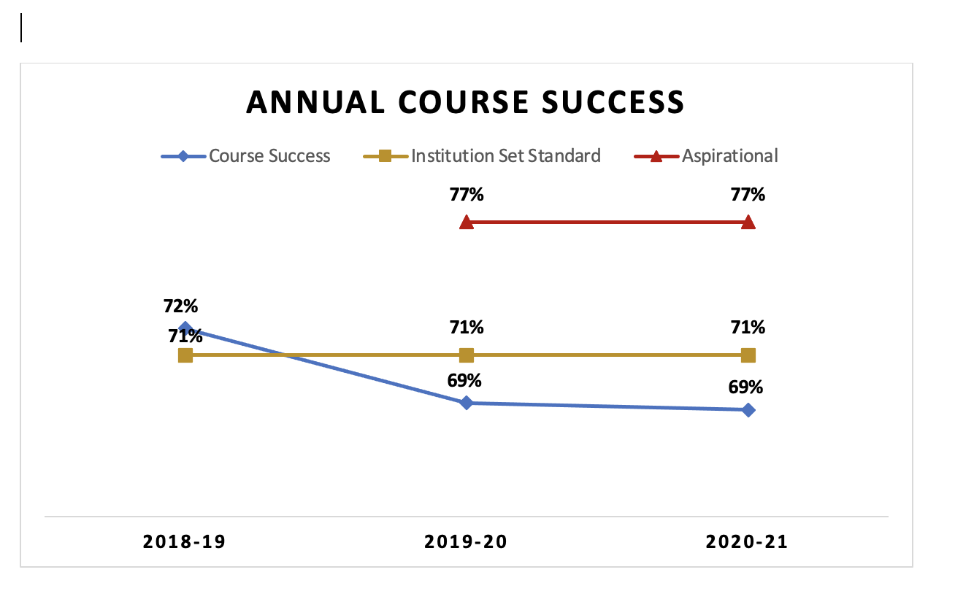
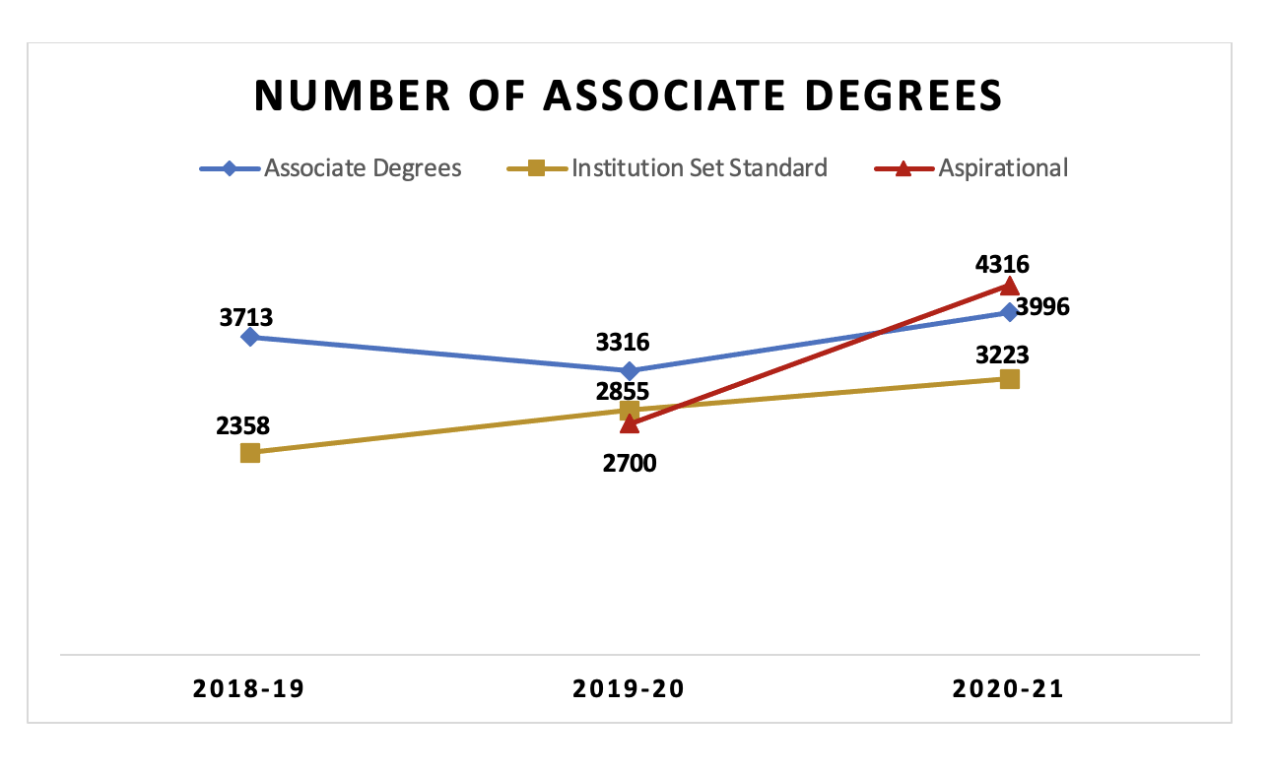
The ISS (institution set standards) cover metrics such as:
the annual course success rate
the number of associate degrees
the number of certificates awarded
the number of students who transfer

Slide 11
The Essential Questions of Accreditation are:
How do we know that we are doing well in our work?
How do we reflect on what we are doing in order to improve?
How do we use the data that we have to aid our reflection?

Slide 12
How many Tattoos do you have?
Notes:
Just as your tattoo tells your story, the ISER is meant to tell Mt. SAC's story!

Slide 13
Writing the Institutional Self-Evaluation Report (ISER) is how we answer the essential questions.
This is our story!
In this cycle, we have created a five-part process!

Slide 14
Preparation was part 1...
Logo design
Contest for the theme/tagline
Initial drafts prepared
Process outlined and timeline created
Fall 2021

Slide 15
Weaving Teams
Weaving Teams
Have faculty, classified, administrative, and student representation to include diverse voices and perspectives
Identify and engage in discussions about representative samples of evidence
Identify areas for improvement
Spring 2022

Slide 16
Resource/Review Teams
Resource/Review Teams
College committees and councils are invited to give feedback on accreditation standards relating to their purpose/function
Essential question: does the ISER narrative accurately reflect the policies, procedures, and practices related to the committee or council's work
August – October 2022

Slide 17
What is your area of expertise?

Slide 18
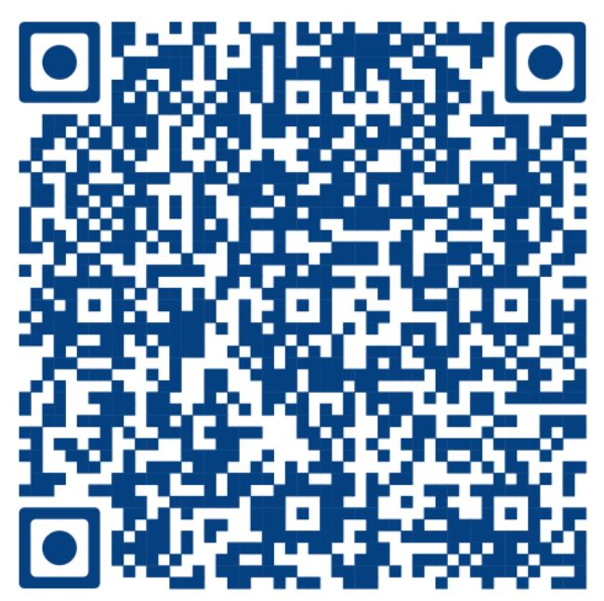
Finishing Teams
Finishing Teams
Choose an area of expertise or interest
Attend a 1-hour convenient training at the September Friday Fall Forum (or today, at 1:00 pm!)
Read a short excerpt from a Weaving Team, review evidence, and give input based on a rubric
Meet with your Finishing Team to compare notes and discuss next steps
Submit Finishing Team input to the Accreditation Steering Committee
Accept our thanks and add accreditation experience to your resume!
Fall 2022
Notes:
We hope you will volunteer. We're recruiting classified, faculty, students and managers.
Session title: "Finish Strong: Join an Accreditation Finishing Team" from 1:00 – 2:15 in Building 12-1080

Slide 19
Why get involved?
Get to know colleagues from many different areas of the college
Hear diverse perspectives
Share ideas about your Mt. SAC expertise – tell your story
Learn more about the college
Celebrate what we do well at Mt. SAC

Slide 20
Campus-wide roll out
Spring 2023
Notes:
This includes the BOT

Slide 21
Overall Timeline
Summer 2022 – Review of process effectiveness
Fall 2022
Resource/review teams
Finishing teams
Friday Fall Forums – 9/16; 10/21; 11/18
Spring 2023 – Roll out to the campus and Board of Trustees
Summer 2023 – Submit the ISER
Fall 2023 – Formative review by ACCJC Peer Team
Spring 2024 – ACCJC Focused Site Visit
Summer 2024 – Celebrate!

Slide 22
Growth from the ISER process...
As the teams continue, we discover where there are gaps and make improvements to better serve students.
Be on the lookout for a gap analysis from Accreditation Steering this fall.
Gap themes will guide Mt. SAC in developing the QFE for the ISER, which outlines targeted improvements.
Notes:
Identifying the gaps is a goal of the process – so it is working as it should!

Slide 23
Friday Fall Forums:
August: Advanced Training from ACCJC
September: Finishing Teams
October: Distance Education/RSI
November: The ISS and Data Coaching
Notes:
Watch your email for the fall accreditation newsletter and meme!

Slide 24
About the Core Team Members...
Samosa
Laksa
Sushi
Carnitas
Dim Sum
Desert first!
Psychology
Education Administration
Single Subject Biology Credential
CLAD Certificate
Certificate in Accreditation
Child Development
Speech Pathology
History
EMT certificate
Law, English Literature
Applied Math, Pure Math
Physics
Computer Science
Social Research Methodology
Laos
Hawaii
Whiskeytown Lake
Japan
Museums
Anywhere!
Singing
Gardening
Reading
Hiking, camping
Traveling
6
Notes:
Team: Kelly Fowler, Lianne Greenlee, Michelle Sampat, Patty Quiñones, Allie Frickert, Barbara Mezaki
Favorite foods, favorite travels destinations, degrees and certificates, hobbies, tattoos
NOTE: Add Patty and Kelly to this slide (I already put math under degrees)

Slide 25
Thank you so much for your attention!
For more information, please go to the Accreditation webpage
Link: https://www.mtsac.edu/accreditation/college_accreditation/2024/index.html

